Slide 1
AIRBNB Dashboards
Dataset link - https://insideairbnb.com/get-the-data/

Slide 2
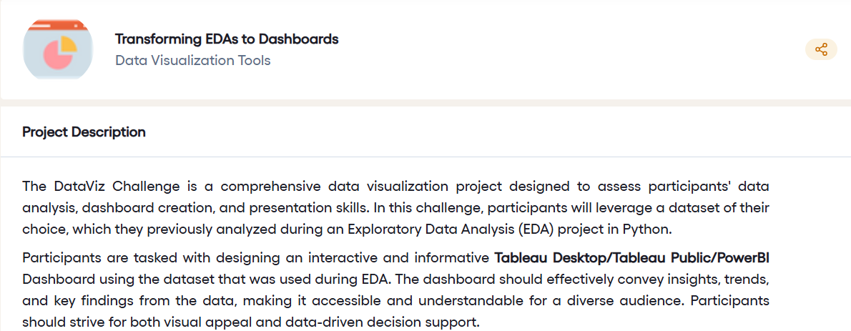

Slide 3
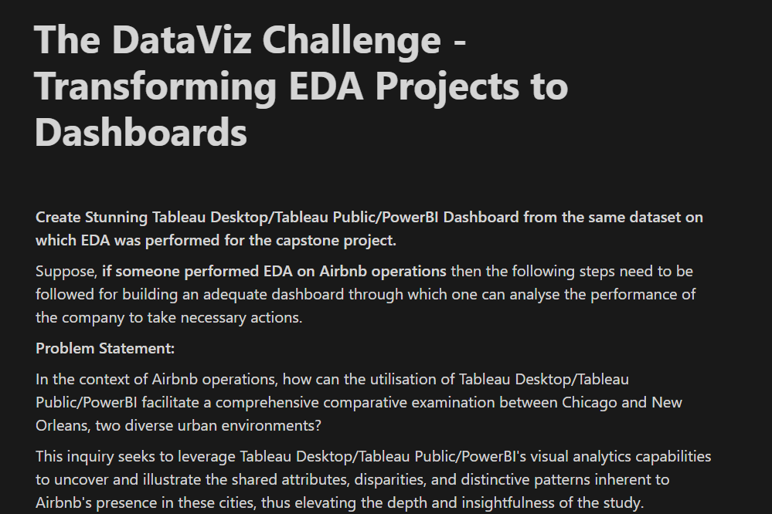

Slide 4
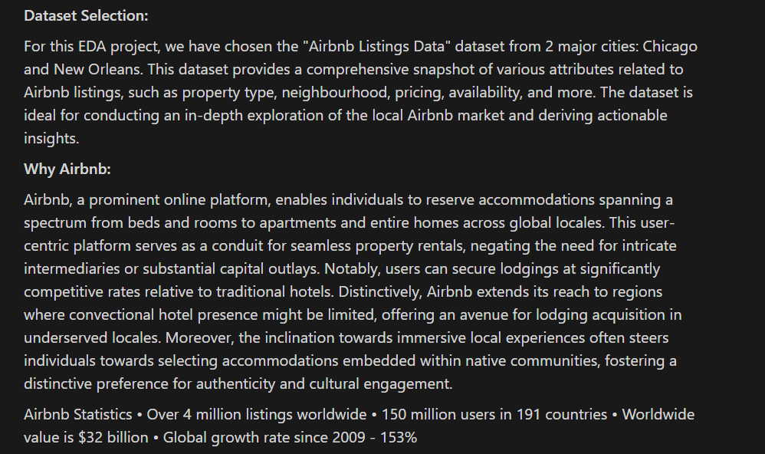

Slide 5
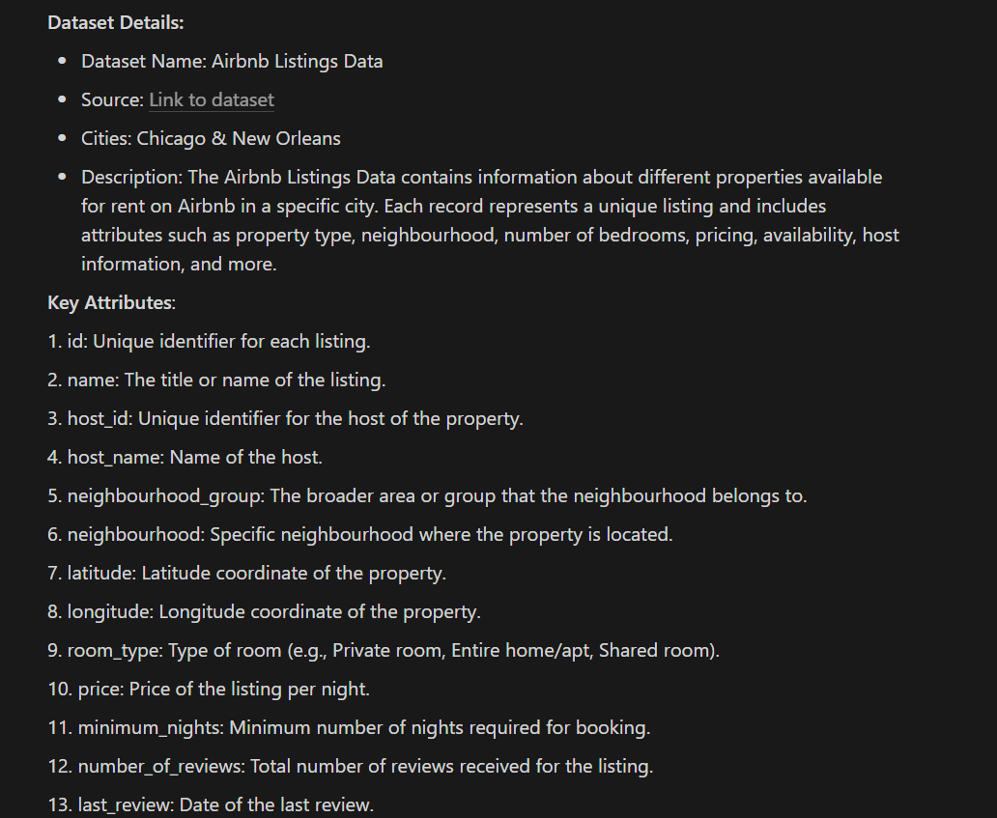

Slide 6
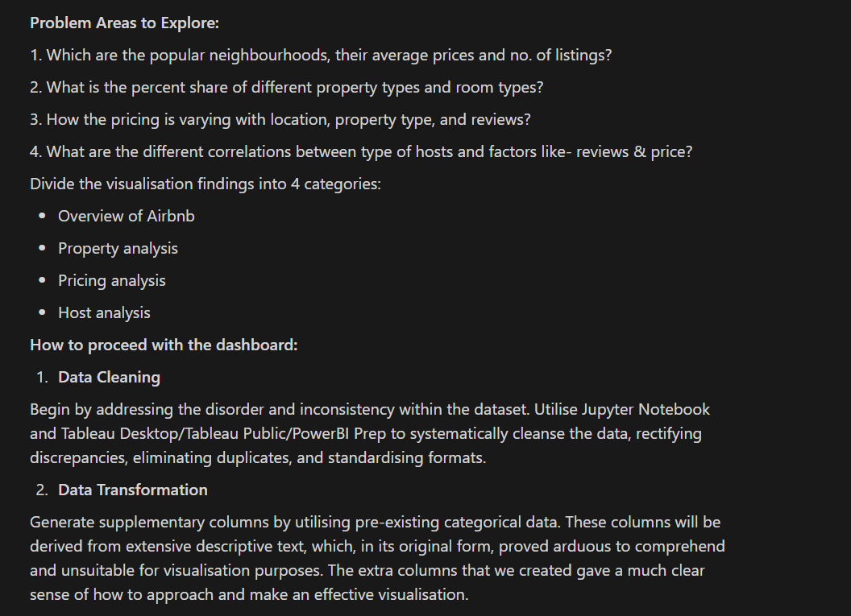

Slide 7


